Slide 1
Intel Unnati Internship
Name : A varun reddy
College : institute of aeronautical engineering college
Roll no : 22951a66h1
Branch : cse-aiml

Slide 2
Problem Statement
Detect Pixelated image & Correct it.
Why is it needed?
Pixelated images are common in various domains like media, photography, and security, leading to poor visual quality and loss of important details. There is a need for an effective solution to enhance and depixelate these images.

Slide 3
Unique Idea Brief (Solution)
Our solution leverages machine learning and image processing techniques to depixelate images.
By training on high-resolution images (1000) and their pixelated counterparts. We also used low resolution images to train this model (this low resolution contains three types of images 2x,3x,4x each one carries 1000 images .
I have trained this model with nine epochs.

Slide 4
I also used pixelated j-pack compression 10 and 20 to train this model each contains 1000 images in the dataset.
And the last type is bi-cubic images, also contains 1000 images for training in it.
We develop a model that can enhance pixelated images efficiently.

Slide 5
Features Offered
- High-resolution output
- Real-time processing
- Support for various image formats
- User-friendly interface

Slide 6
Model Architecture
Details of the deep learning model used for depixelizing images.
Input layers, Convolutional Layers, Batch Normalization Layers, Up sampling layers, Output Layer
Evaluation Metrics: Functions to compute metrics like PSNR and SSIM.

Slide 7
Process Flow
1. Image Input
2. Preprocessing
3. Model Application
4. Postprocessing
5. Image Output

Slide 8
Technologies Used
- Python
- TensorFlow
- OpenCV
- NumPy
- Pandas
- Git
- Docker

Slide 9
Work Done…
- Model Development
- Data Collection and Preprocessing
- UI Design
- Testing and Validation

Slide 10
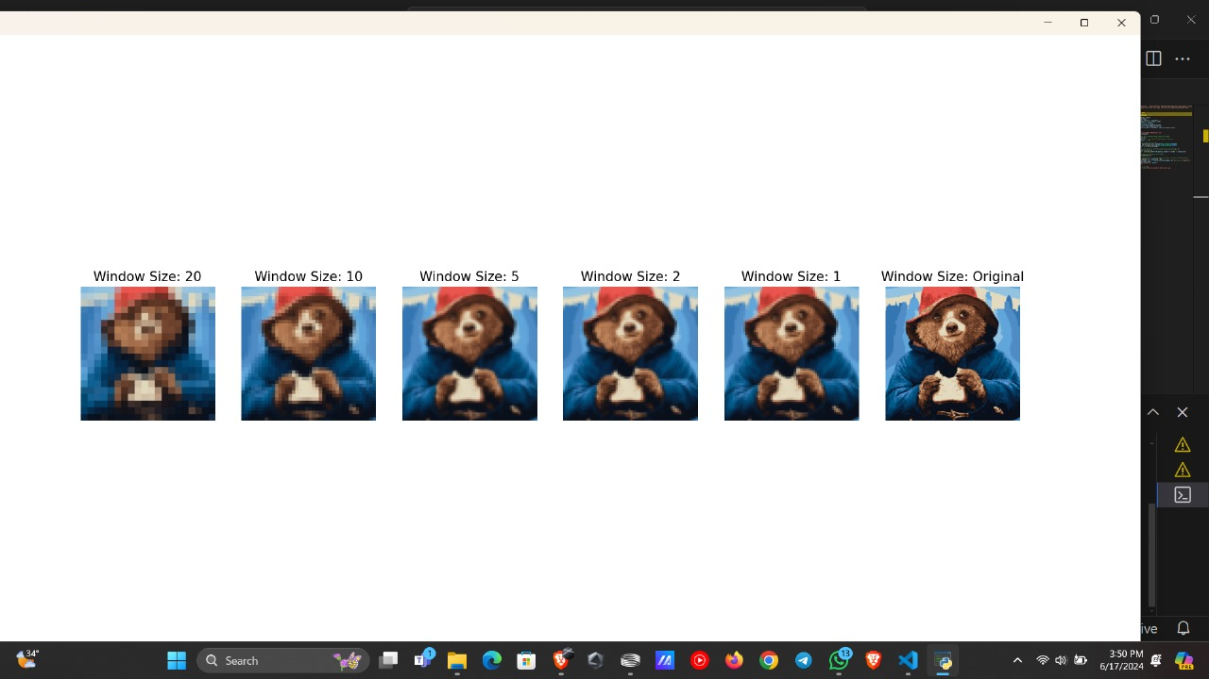
Git-hub links : https://github.com/varun240s/IMAGE-DEPIXELIZATION
Data sets : https://github.com/varun240s/IMAGE-DEPIXELIZATION/tree/main/data/test

Slide 11
Conclusion
My project presents an innovative approach to image depixelization using advanced machine learning techniques. It enhances image quality, making it useful for various applications in media, security, and photography. The project has significant potential for future development and improvements.

Slide 12
Thank you

